Slide 1
Investigating Washington Dams and Aquatic Inventory & Monitoring Data
Jackie Van Der Hout, Andrew Friedman-Herring, & Catherine Otero

Slide 2
Research Questions
How many dams are upstream of the gage sites?
How do the variables measured at each gage site correlate?
How do the number of dams correlate with the AIM variables?
Why ask?
See the extent of the damming in Washington
See the impact of dams on AIM variables

Slide 3
Data Used
BLM Assessment, Inventory, and Monitoring (AIM) Data
Washington State Department of Ecology Inventory of Statewide Dams
National Hydrography Dataset of Flowlines and Catchments, developed by the US EPA and USGS

Slide 4
Data Wrangling
Data scraping publicly available geospatial data for AIM and dam data
Using NHDplustools package to extract hydro data from the NHD

Slide 5
Analysis of the Data
Analytical approaches
Correlations among and within variables
Geospatial tools to assess number of dams in catchments flowing into sample sites

Slide 6
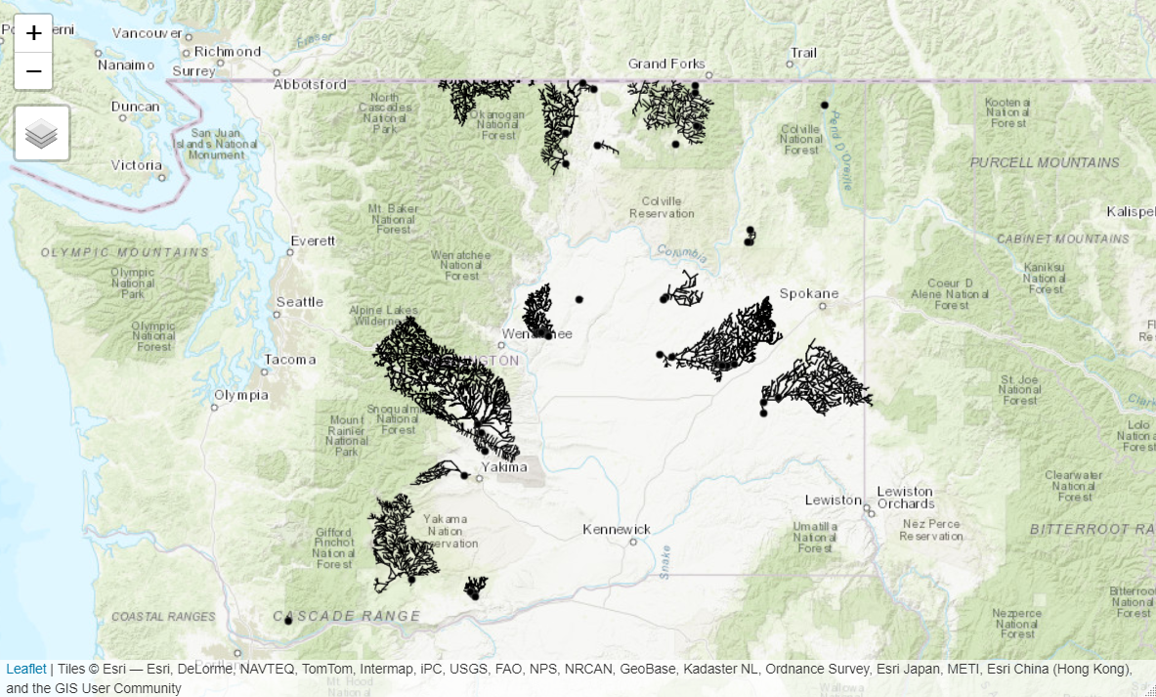
Results of the Analysis

Slide 7
Where are the AIM sample sites and their catchments?

Slide 8
Where are all of dams in Washington State?

Slide 9
Catchments, Dams, and Sample Sites

Slide 10
Water Quality Correlation Plot

Slide 11
Biodiversity and Riparian Habitat Quality Correlation Plot

Slide 12
Watershed Function and Instream Habitat Quality Correlation Plot

Slide 13
Next Steps
Running an AIC
Running regression
Calculating flowline distances with NHDtoolsplus
Comparing on AIM variables between sample site catchments on the basis of # of dams, dams / square mile, and flowline distance to dams

